Slide 1


LOX and Oxygen Fire Safety Training
Welcome to the LOX and Oxygen fire safety Training. The Goal of this training is to make you aware of all the potential hazards that come with working with LOX. If there is anything that you take away from this training today, it’s this – if you are unsure about the safety or flammability of a system/substance – DO NOT Proceed until it has been sufficiently checked/deemed as safe by team leads, after having been analyzed by safety standards and research. Please feel free to ask as many questions throughout the training.

Slide 2
LOX and Oxygen Fire Safety Training
**NOTE**: Taking this training does not automatically qualify you to work with LOX on the team. No one should ever be handling LOX casually. Its use should be restricted for firing events only.
When it is time to use LOX, you must be familiar with the standard procedures for the task and be trained on how to do the task as well. It is never ok to assume that taking this training makes you familiar enough to complete a task you have never done before.

Slide 3
LOX and Oxygen Fire Safety Training
Facts of Oxygen
Hazards of LOX
Things to Consider
Resources to Reference
Application to Our System
Handling

Slide 4
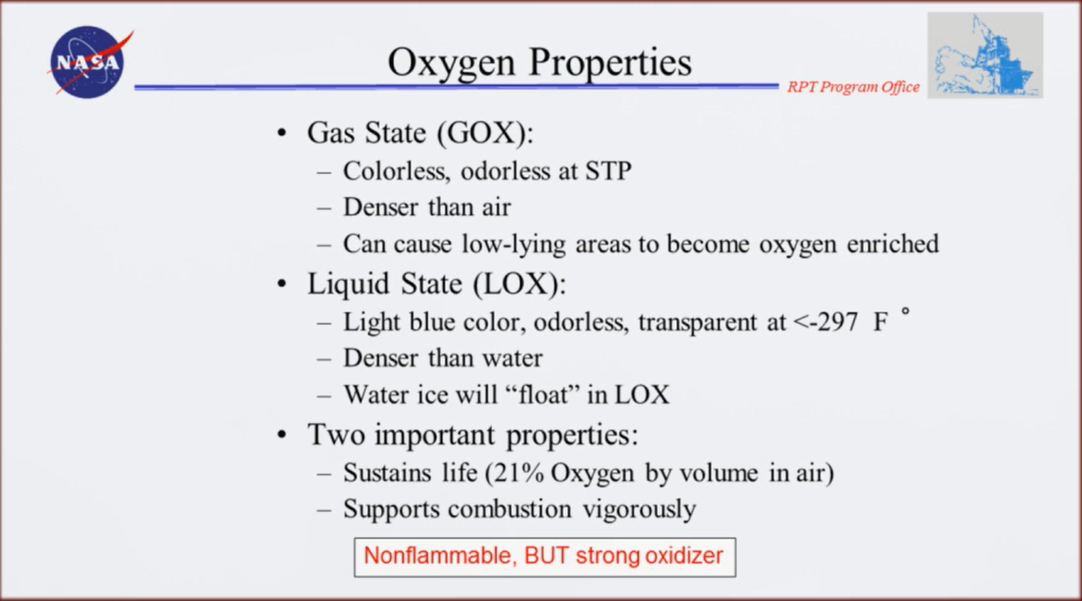
Facts of Oxygen

Slide 5
Facts of Oxygen
Oxygen is denser than air – this means that it will sink in air. There are numerous stories of people getting set on fire due to medical oxygen settling on themselves
Question: Is oxygen flammable?

Slide 6
Facts of Oxygen
Small Sample of NASA Fire History
Apollo 1
Apollo 13 (1970)
EMU Fire (1980)
MIR Fire (1997)
Orb 3 Fire (2013)
The most high level professionals still lose missions and progress due to fire – we absolutely must take care and precaution
https://www.youtube.com/watch?v=q4WIC5mDibg
Notes:
https://www.youtube.com/watch?v=q4WIC5mDibg

Slide 7
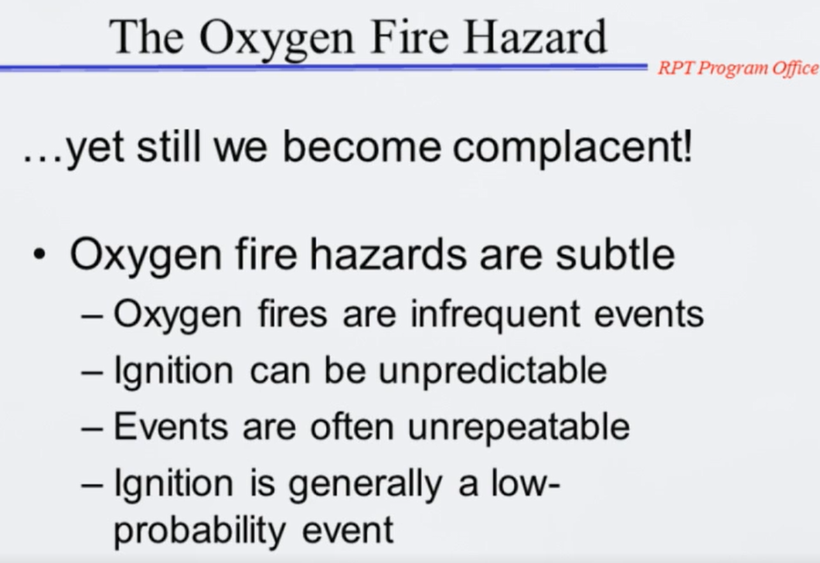
Facts of Oxygen
Despite all this, we must continue to be diligent in taking the precautions. Just because we have not encountered a problem does not mean it won’t happen

Slide 8
Things to Consider
Oxygen Fires burn more vigorously with increasing pressures and concentrations!
So for our systems with pressures significantly higher than standard atmosphere, fires can start and burn very quickly

Slide 9
Things to Consider
Apollo 1
From the moment the screams of Fire! Started, to the last second any cries for help were heard, it was only 11 seconds
How did a small spark cause such a huge problem?
Oxygen enriched cabin caused everything in the cabin to be flammable
Within the 11 seconds, so many things had caught fire, enough toxic smoke was produced to kill them
https://www.youtube.com/watch?v=7cN6P1xtdz8
Notes:
https://www.youtube.com/watch?v=q4WIC5mDibg

Slide 10
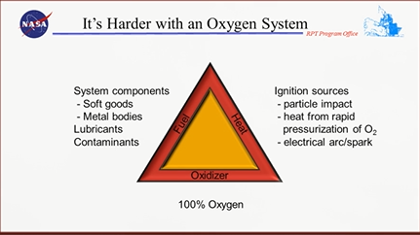
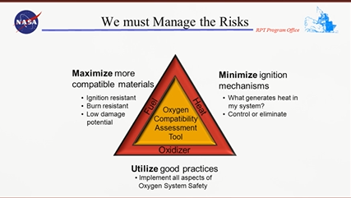
Things to Consider
How do we eliminate fires?
Remove at least 1 of Oxidizer, Fuel, or Heat/Ignition
In oxygen enriched environments, practically everything is a fuel! Including metals, including valves, etc.

Slide 11
Resources
NASA Oxygen Incident Database:
http://wiki.nasa.gov/oxygen-fire-incidents/
All public info about such accidents can be found here.
An important resource for double checking our designs and procedures

Slide 12
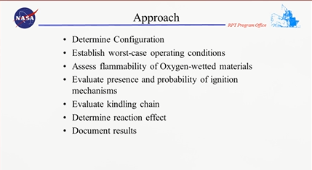
Resources
Our team needs to be able to document our processes and reasons behind our choices of materials, designs, etc.
ASTM D2863 – Oxygen Index Test <- standard test for flammability
Manual 36, p29 – 35, Table 3-12 <- ranks flammability of different materials

Slide 13
Resources
Manual 36, p18-20, Table 3-1<-Flammability data for Metals
For all these manuals and resources, we need to be careful of the application of the data. If the configuration, pressure, material thickness, etc. are differ from the test data, we need to check to see if logically it is valid to apply the test data
Manual 36, p21, Table 3-2 <- Data for Wire Meshes
Manual 36, p21, Table 3-3 <- Data for Sintered Filters

Slide 14
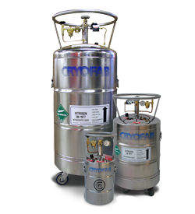
Application for Our Team
We will be using LOX Dewars to fill our system – the two main hazards associated with these are the extreme cold of the liquid, and fires due to the enriched oxygen environments

Slide 15
Handling
Liquid oxygen is stored at cryogenic temperatures – it can burn the skin just like extreme heat. NEVER let LOX come into contact with the skin nor soak clothing
When handling LOX, personnel is advised to use goggles and cryogenic leather gloves. Long pants and high topped shoes must also be worn in order to protect the lower body.
Liquid oxygen must never be poured upon clothing, fabrics, rags, waste or other readily combustible materials

Slide 16
Handling
Liquid oxygen should never be poured or demonstrated in close proximity to a source of ignition. A spark coming into contact with a combustible material in an oxygen-enriched atmosphere can burst into flames and immediately cover the surface of the combustible material.
When pouring liquefied gases from one container to another, the receiving container should be cooled gradually to prevent thermal shock. The liquid should be poured slowly to avoid spattering. The receiving vessel should always be vented to the atmosphere and high concentrations of gaseous oxygen and/or nitrogen should not be allowed to collect

Slide 17
Handling
Whenever a cryogenic liquid comes into contact with room temperature substances, a large amount of boiling occurs, which may result in splashing. Personnel need to be aware of such hazards and wear the necessary protection such as goggles, or a full face shield.

Slide 18
Other cautions
When used with valves and fittings for our rocket system, it is absolutely necessary that the proper fittings are used and have been cleaned according to the UCIRP Liquid Oxygen-Methane Plumbing Preparation Requirements LOX cleaning procedure.
Unclean fittings are considered a hazard and may be easily ignitable

Slide 19
Questions?
In each event that our team will be utilizing LOX, there will be a strict set of procedures that must be followed. Failure to follow such procedures could result in serious injury/fatality.
Please never get overconfident! Remember that it is not only your own safety at stake, but the safety of others as well!

